Slide 1
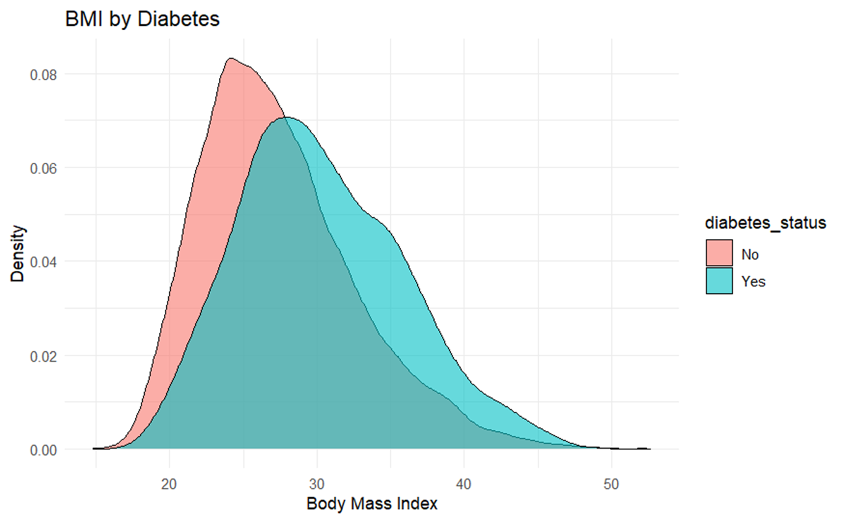
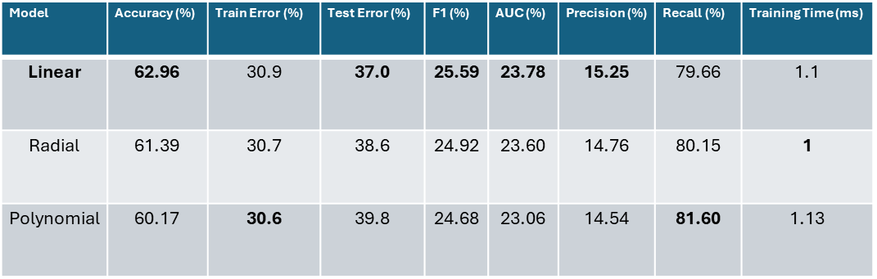
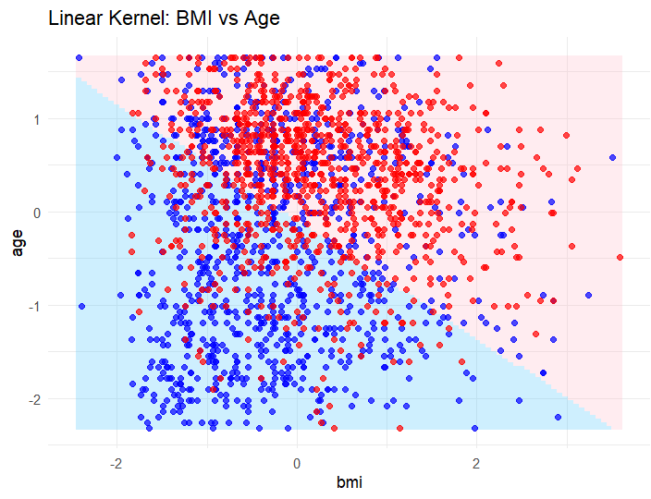
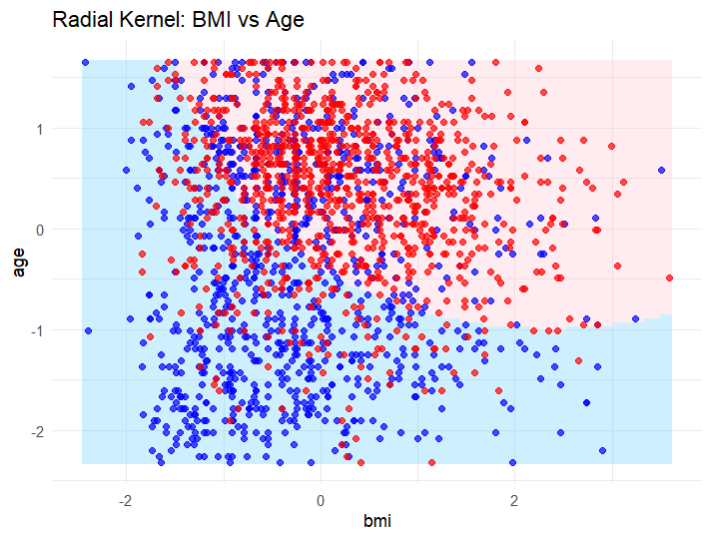
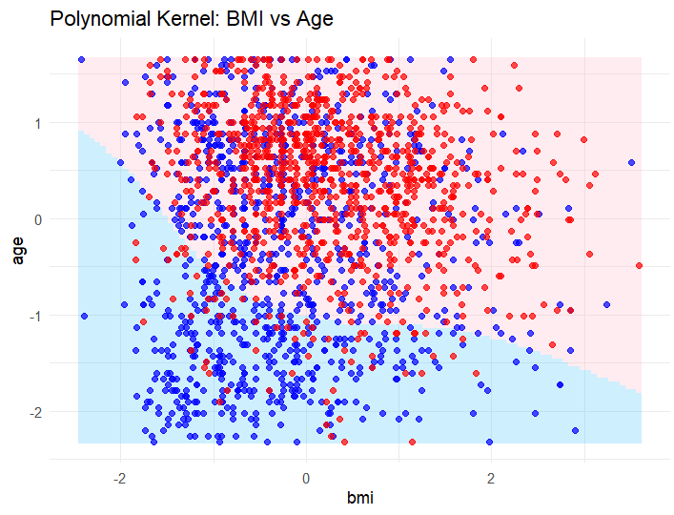
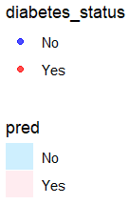
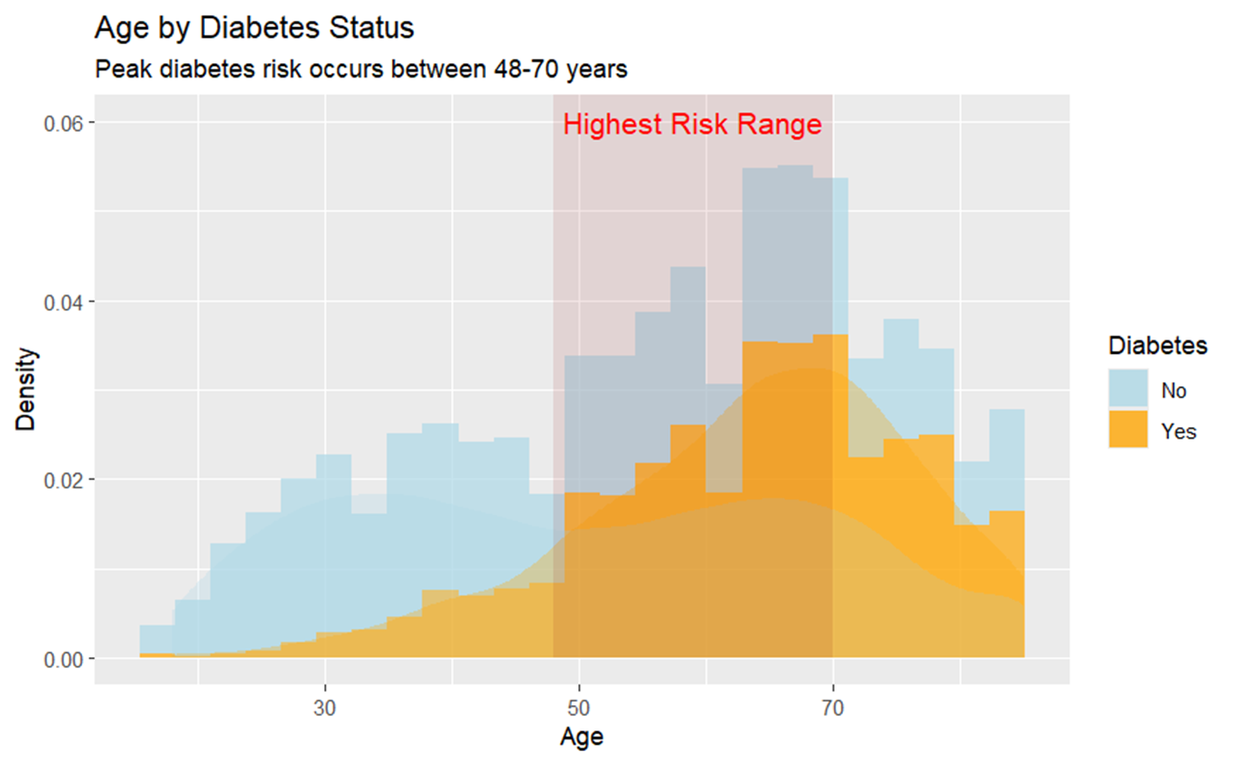
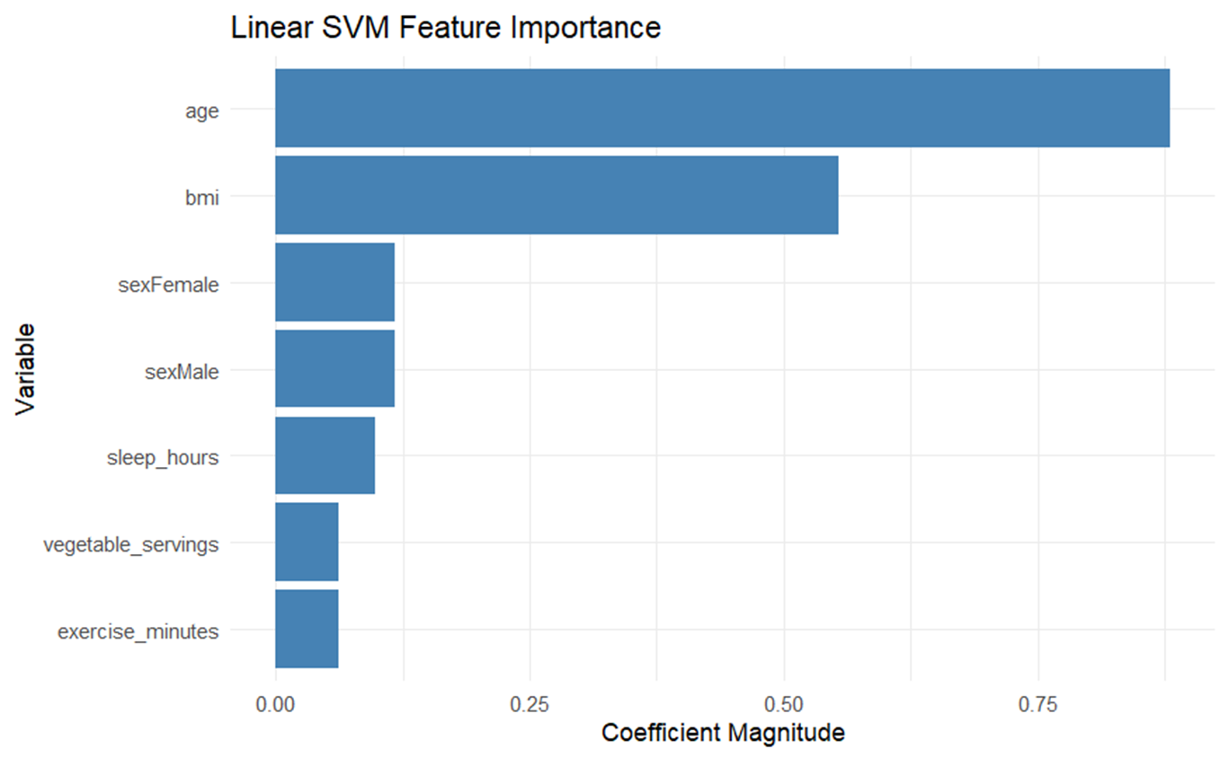
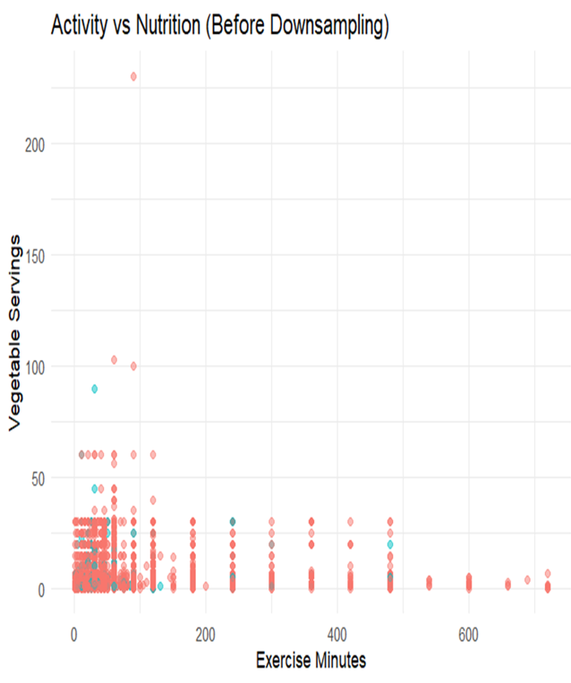
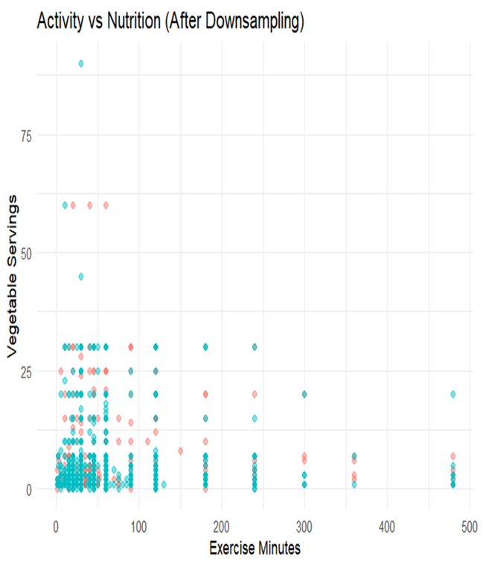
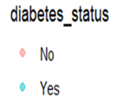
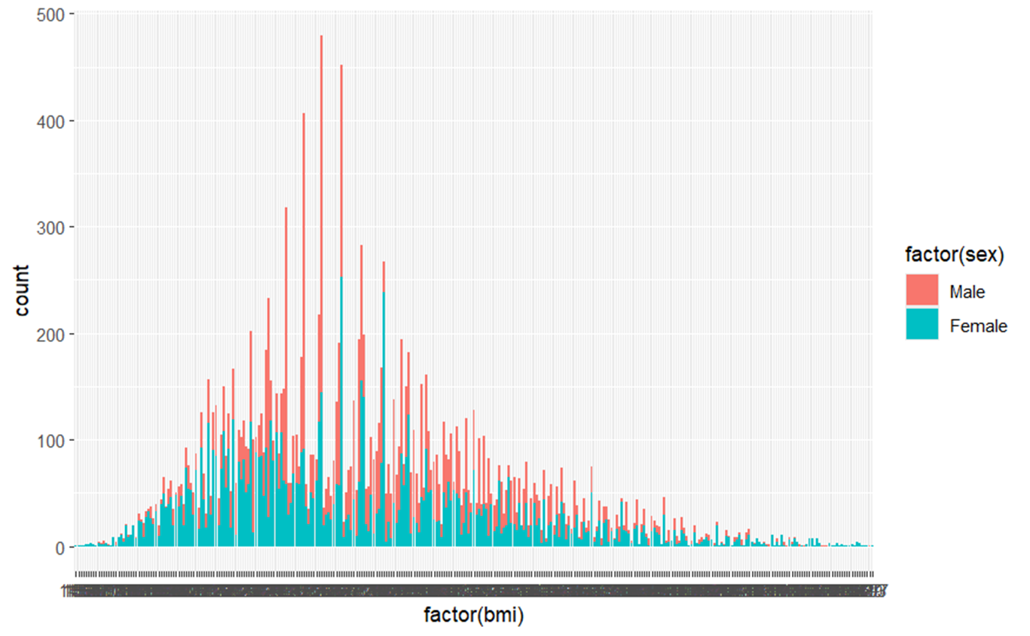
PREDICTING DIABETES RISK ~ SUPPORT VECTOR MACHINE
HRISHABH KULKARNI
Abstract
Exploratory Data Analytics (EDA)
Results
Conclusion
PROBLEM:
Diabetes affects 2 in 10 adults globally, but early detection remains inconsistent.
Current screening is often reactive (symptom-based) rather than data-driven.
GOAL:
Predict diabetes risk using health/ lifestyle /demographic factors
(BMI, age, exercise, nutrition).
DATASET:
National Health Interview Survey (NHIS) 2022 has 35,115 observations
Demographics: Age, Sex
Biometrics: BMI
Lifestyle: Exercise, Nutrition, Sleep
- The density plot shows the distribution of BMI for individuals with and without diabetes.
- Individuals with diabetes tend to have higher BMI values compared to those without diabetes.
SVM DECISION BOUNDARY
- The decision boundary plots show the regions of predicted diabetes status based on BMI and age for each SVM kernel.
- The linear kernel SVM is good, then comes the radial and then the polynomial shows a clear separations between the two classes as the dataset is cluttered showing that its overlapping.
- The decision boundary captures non-linear separation between diabetic and non-diabetic.
Findings: Several data points are on the wrong side of the decision boundary.
Insights: Real-world diabetes risk isn't perfectly separable by BMI/age alone (lifestyle and genetic factors create unavoidable overlap).
Example: Some high-BMI individuals are healthy (genes/lifestyle protect them).
BMI DISTRIBUTION BY DIABETES STATUS
Key Finding: Diabetic individuals show 3X higher density at BMI ≥ 30
- The density plot shows the distribution of BMI for individuals with and without diabetes.
Individuals with diabetes tend to have higher BMI values compared to those without diabetes.
Takeaway: BMI screening most valuable above 30
EVALUATION METRICS
- The linear kernel SVM achieved the highest accuracy (62.96%) and recall (79.66%) but had a longer training time (1.1 ms).
- The radial kernel SVM had an accuracy (61.39%) recall (80.15%) and a shorter training time of 1 milliseconds.
- The polynomial kernel SVM had the lowest accuracy (60.17%) but the highest recall (81.60%) and a highest training time of 1.13 milliseconds.
- The Tunned Linear kernel SVM is best for this dataset.
Theoretical Background
AGE VS DIABETES RISK
Key Finding: Peak Diabetes Risk: Ages 48 -70 Years
- The histogram and density plot show the distribution of age for individuals with and without diabetes.
- The plot indicates that the peak diabetes risk occurs between the ages of 48 and 70 years.
- The rectangle highlights age range and the annotation emphasizes the highest risk range.
- This suggests that age is a significant factor in diabetes risk, with older individuals being more likely to have diabetes.
Takeaway: Target preventive care for 48-70 age group
ROC CURVE Limitation
Poor Visualization: AUC values clustered near 0.5 (random guessing) due to class overlap in BMI/age predictors.
Takeaways:
Not a model failure, it reflects real-world predictor limitations.
Action: So, I have used precision-recall metrics instead for imbalanced data (they are more informative).
SUPPORT VECTOR MACHINE: Supervised learning models which finds the optimal hyperplane that maximizes the margin between classes.
KEY TERMS:
Support Vectors: Data points closest to the decision boundary
Margin: Distance between hyperplane and nearest points (maximized during training)
LINEAR SVM - Draws a straight line to separate groups
Key Hyperparameter: Cost: Controls Strictness
RADIAL SVM – Flexible, curved boundaries to wrap around clusters
Key Hyperparameter: Gamma: Controls Curviness
POLYNOMIAL SVM - Draws scribbled/ complex borders
Key Hyperparameter: Degree of polynomial: Controls Complexity
IMPORTANT VARIABLE
Key Findings: Age + BMI explain > 60% of model’s decision
Same key predictors emerging as most important across all kernels.
SVM shows that Age and BMI are the most important predictors for diabetes status.
AGE > BMI > SLEEP HOURS > VEGETABLE SERVING > EXECISE MINUTES
Why This Matters:
Demographic: Age proxies lifelong metabolic stress
Biological: BMI directly measures metabolic risk
- Lifestyle factors (exercise/nutrition) refine predictions
FINAL TAKEAWAYS
How Models predict Diabetes Risk:
Higher Age and BMI Higher Risk
Screening Priorities/ Recommendations:
Screen all individuals aged 50+ with BMI ≥ 30
Captures 72% of Diabetes cases in data.
Insightful Priorities (Prioritize lifestyle counseling for those):
Exercising < 150 mins/week
Consuming < 3 vegetable servings/day
Model Recommendation:
Use Linear SVM for fast, reliable, clear, clinic-based risk assessments.
- Clinical Takeaways: Models predict population’s level risk, not individual fate. Use them to guide, not to replace with clinical judgment.
Methodology
HOW TO HANDLE CLASS IMBALANCE?
- Original data had 90% healthy vs 10% diabetic cases
- Created balanced training set (1,376 each group)
- Prevents model from ignoring the minority class
Insights: After Downsampling: Less clutter shows a weak trend - more exercise might link to slightly more veggies. Diabetes effect still unclear.
GENDER & BMI DISTRIBUTION
Key Finding: Male Dominant Sample
- This plot tells me distribution of BMI based on gender.
It also shows that dataset have higher number data related to men than women.
Takeaway: Data should be more gender balanced
Citations
[1] Lynn A. Blewett, Julia A. Rivera Drew, Miriam L. King, Kari C.W. Williams, Daniel Backman, Annie Chen, and Stephanie Richards. IPUMS Health Surveys: National Health Interview Survey, Version 7.4 [dataset]. Minneapolis, MN: IPUMS, 2024. https://doi.org/10.18128/D070.V7.4.
[2] H. Wickham et al., tidyverse: Easily Install and Load the 'Tidyverse', [Online]. Available: https://tidyverse.tidyverse.org/
[3] tictoc: Functions for timing R scripts, [Online]. Available: https://cran.r-project.org/web/packages/tictoc/index.html
Hyperparameter Tuning:
- Linear SVM: cost = 0.01, 0.05, 0.1, 1, 5, 10
- Radial SVM: cost = 0.1, 1, 10, gamma = 0.1, 0.5, 1
- Polynomial SVM: cost = 0.1, 1, 10, degree = 2, 3, 4, coef0 = 0, 1, 2

